Slide 1



INTRO TO
& SCRUM
LENKA ZUBCOVA
Scrum Master Chapter Lead, VODAFONE CZ

Slide 2
AGENDA
Agile! Co?
Klíčové principy
Scrum

Slide 3

AGILE
Schopnost „fungovat“ rychle a snadno
Metoda řízení projektů, používaná
zejména při vývoji softwaru, která se vyznačuje rozdělením úkolů do krátkých pracovních fází a častým přehodnocováním a přizpůsobováním plánů.
volně přeloženo z Oxford Languages

Slide 4

AGILE! CO?

Slide 5
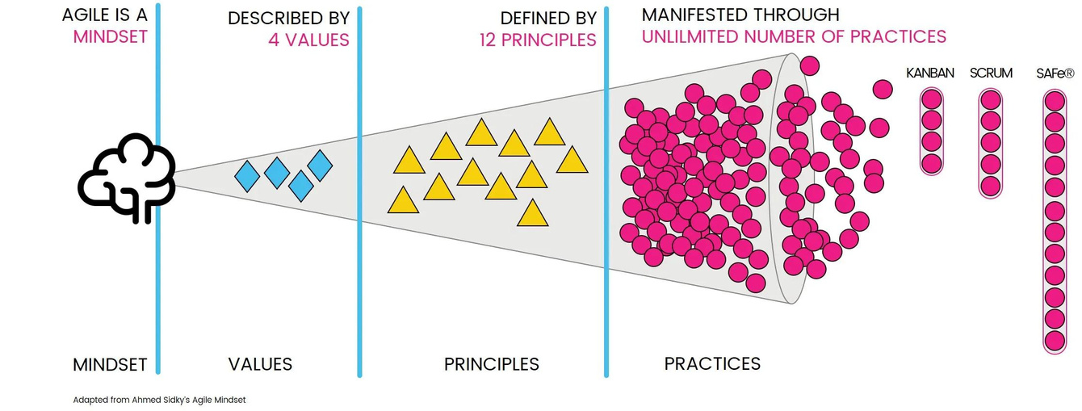
CO JE AGILE?

Slide 6
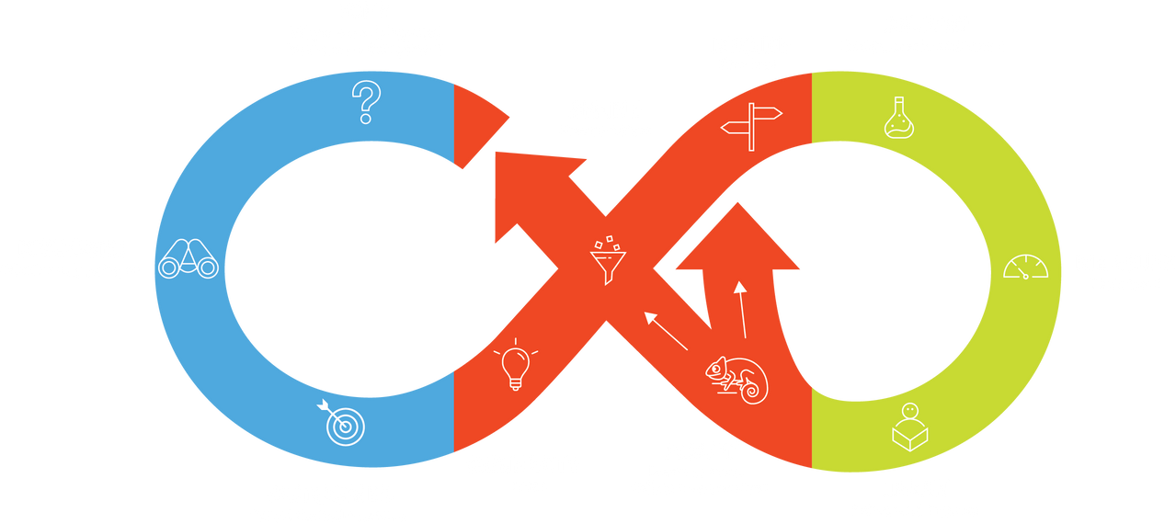
KLÍČOVÝ PRINCIP
EFEKTIVNÍ KOMUNIKACE
KONTINUÁLNÍ ZPĚTNÁ VAZBA (FEEDBACK)
BÝT FLEXIBILNÍ
Změna směru je rychlá & plynulá.

Slide 7


MŮŽEME DĚLAT COKOLI
ROZSAH
KVALITA
NÁKLADY/ZDROJE
ČAS
ALE NE VŠECHNO
Notes:
https://www.productboard.com/glossary/agile-principles/
Along with the four values of the Agile Manifesto, there are 12 principles.
These principles go into a little more detail and expand upon the four values.
1
This agile principle encourages teams to shorten the gap between initial ideation and releasing a working product.
The sooner customers can use your product, the sooner you can collect feedback and make the appropriate improvements.
5
If you have the right team in place, all you need to do is give them the right working environment and any support or resources they need. This removes the need for hand-holding and micromanagement.
10
Don’t juggle development time across a wide range of irrelevant activities. The Agile Manifesto suggests that teams should spend the majority of their time on the few most important things.
To do this, teams need to think strategically and ruthlessly prioritize the features they work on.
11
In traditional hierarchical teams, there will generally be somebody at the top of the chain making the final decisions.
A flatter hierarchy, where everyone gets an equal say, can lead to more effective software development.

Slide 8

The most important thing
is to keep the most important thing the most important thing.
Jim Kwik, Limittless

Slide 9


SCRUM
Rámec pro vývoj komplexních produktů.
Commitment (závazek) k dokončení konkrétního incrementu (pracovního přírůstku) v definovaném pracovním úseku (sprintu).
Humphrey's law:
People don't know what they want
until they see what they don't want.
Notes:
https://www.productboard.com/glossary/agile-values/
Value 1: Individuals and interactions
In the past, a lot of software teams would concentrate on having the best possible tools or processes with which to build their software. The Agile Manifesto suggests that while those things are important, the people behind the processes are even more so.
Having the right group of individuals on your software team is vital to success. The best possible tools in the wrong hands are worthless. Perhaps even more important is how these individuals communicate with each other. The interactions between team members are what helps them to collaborate and solve any problems that arise.
Value 2: Working software
Previously, software developers would spend ages creating detailed documentation. That was before they even started writing a single line of code. And while documentation isn’t a bad thing, there comes a point when you should focus on providing your customers with working software.
The Agile Manifesto places shipping software to your customers as one of the highest priorities. You can then gather feedback to help you improve future releases.
Value 3: Customer collaboration
Once upon a time, contracts were king. You would draw up contracts with your customers who would then detail the finished product. As a result, there was often a contrast between what the contract said, what the product did, and what the customer actually required.
According to the Agile Manifesto, the focus should be on continuous development. You need to build a feedback loop with your customers so that you can constantly ensure that your product works for them.
Value 4: Responding to change
Can you imagine a time where you would draw up a roadmap and it would never change? Well, in the past that’s exactly what happened.
The trouble with static roadmaps is that we don’t live in a static world. Needs and requirements are always shifting, and priorities are always changing. That static roadmap will soo

Slide 10
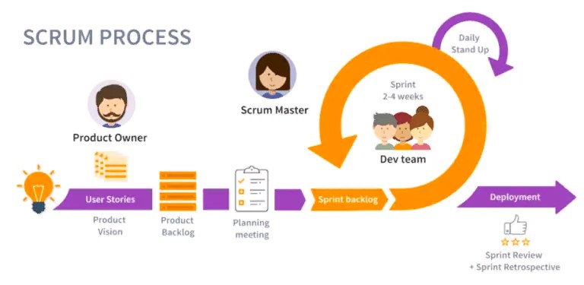
CO JE SCRUM
Notes:
https://www.productboard.com/glossary/agile-principles/
Along with the four values of the Agile Manifesto, there are 12 principles.
These principles go into a little more detail and expand upon the four values.
1
This agile principle encourages teams to shorten the gap between initial ideation and releasing a working product.
The sooner customers can use your product, the sooner you can collect feedback and make the appropriate improvements.
5
If you have the right team in place, all you need to do is give them the right working environment and any support or resources they need. This removes the need for hand-holding and micromanagement.
10
Don’t juggle development time across a wide range of irrelevant activities. The Agile Manifesto suggests that teams should spend the majority of their time on the few most important things.
To do this, teams need to think strategically and ruthlessly prioritize the features they work on.
11
In traditional hierarchical teams, there will generally be somebody at the top of the chain making the final decisions.
A flatter hierarchy, where everyone gets an equal say, can lead to more effective software development.

Slide 11

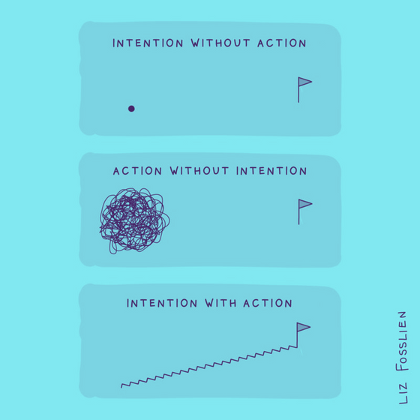
Bez cíle nemůžete skórovat.

Slide 12

DĚKUJI!
Notes:
https://www.productboard.com/glossary/agile-values/
Value 1: Individuals and interactions
In the past, a lot of software teams would concentrate on having the best possible tools or processes with which to build their software. The Agile Manifesto suggests that while those things are important, the people behind the processes are even more so.
Having the right group of individuals on your software team is vital to success. The best possible tools in the wrong hands are worthless. Perhaps even more important is how these individuals communicate with each other. The interactions between team members are what helps them to collaborate and solve any problems that arise.
Value 2: Working software
Previously, software developers would spend ages creating detailed documentation. That was before they even started writing a single line of code. And while documentation isn’t a bad thing, there comes a point when you should focus on providing your customers with working software.
The Agile Manifesto places shipping software to your customers as one of the highest priorities. You can then gather feedback to help you improve future releases.
Value 3: Customer collaboration
Once upon a time, contracts were king. You would draw up contracts with your customers who would then detail the finished product. As a result, there was often a contrast between what the contract said, what the product did, and what the customer actually required.
According to the Agile Manifesto, the focus should be on continuous development. You need to build a feedback loop with your customers so that you can constantly ensure that your product works for them.
Value 4: Responding to change
Can you imagine a time where you would draw up a roadmap and it would never change? Well, in the past that’s exactly what happened.
The trouble with static roadmaps is that we don’t live in a static world. Needs and requirements are always shifting, and priorities are always changing. That static roadmap will soo

